Slide 1
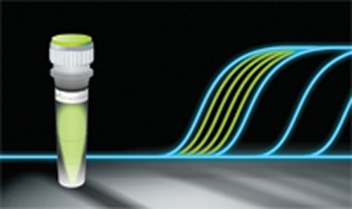
PCR Quantitation (qPCR)
Present by: Niloofar Neisi
PhD of Virology

Slide 3
How does real-time PCR work?
To best understand what real-time PCR is, let’s review how regular PCR works...

Slide 4
The Polymerase Chain Reaction How does PCR work??

Slide 9
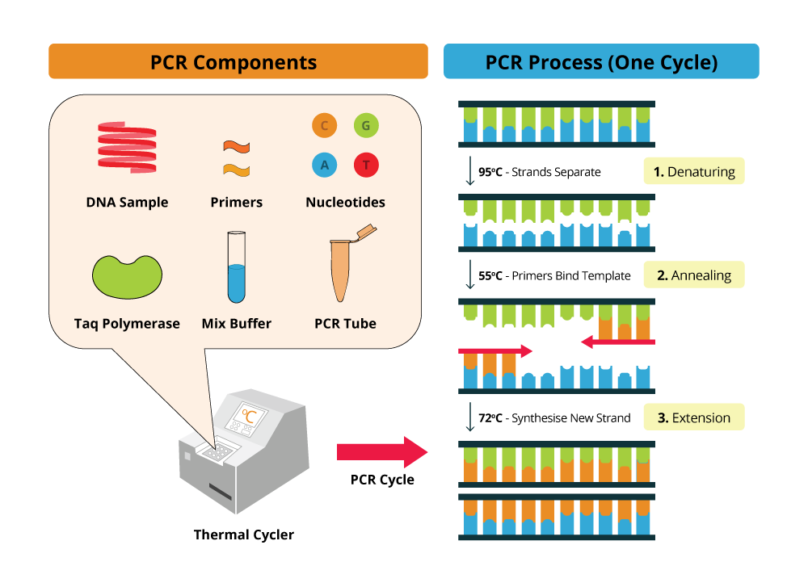

Slide 10
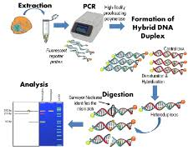
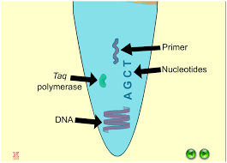
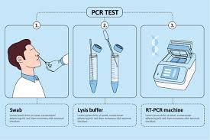

Slide 11
Gel base detection

Slide 12
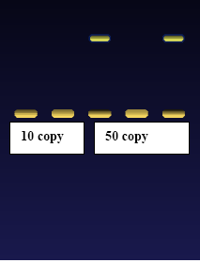
What’s Wrong With Agarose Gels?
Low sensitivity
Low resolution
Non-automated
Size-based discrimination only
Results are not expressed as numbers
→ based on personal evaluation
Ethidium bromide staining is not very quantitative
End point analysis

Slide 13
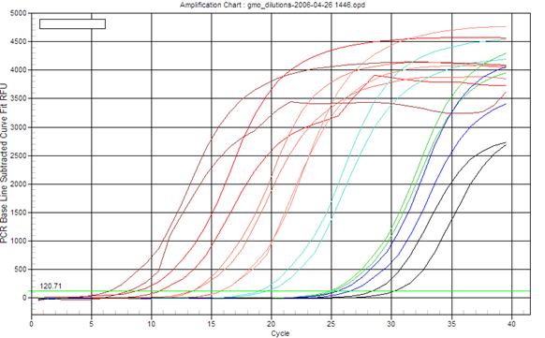
What is Real-Time PCR?
The Polymerase Chain Reaction (PCR) is a process for the amplification of specific fragments of DNA.
Real-Time PCR a specialized technique that allows a PCR reaction to be visualized “in real time” as the reaction progresses.
As we will see, Real-Time PCR allows us to measure minute amounts of DNA sequences in a sample!
real time : the actual time during which a process or event occurs

Slide 14
What is Real-Time PCR?
Differences with normal PCR?
20ul PCR reactions
SYBR Green or probes
94°C 4 min
94°C 15 sec
61°C 30 sec
72°C 30 sec
40x

Slide 15
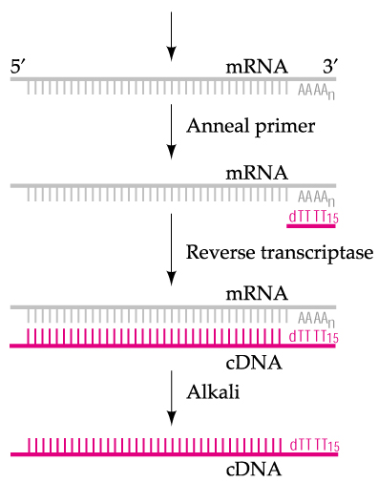
What is Real-Time PCR?
Taq polymerase can only synthesize DNA, so how do we study gene expression (RNA) using qPCR?
Reverse transcription
RNA -> DNA (cDNA)

Slide 16
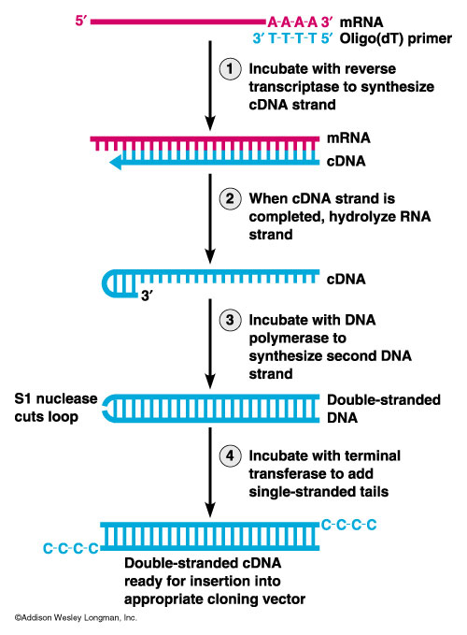

Slide 17
This is equivalent to approximately 100 pg to 1 μg of genomic DNA, or cDNA generated from 1 pg to 100 ng of total RNA.

Slide 18
Two-step qRT-PCR
Two-step quantitative reverse transcriptase PCR (qRT-PCR) starts with the reverse transcription of either total RNA or poly(A)+ RNA into cDNA using a reverse transcriptase (RT).
This frst-strand cDNA synthesis reaction can be primed using random primers, oligo(dT), or gene-specifc primers (GSPs).
To give an equal representation of all targets in real-time PCR applications and to avoid the 3 bias of oligo(dT) primers, many researchers use random primers or a mixture of oligo(dT) and random primers.
The temperature used for cDNA synthesis depends on the RT enzyme chosen.
Next, approximately 10% of the cDNA is transferred to a separate tube for the real-time PCR reaction.

Slide 19
One-step qRT-PCR One-step qRT-PCR combines the first-strand cDNA synthesis reaction and real-time PCR reaction in the same tube, simplifying reaction setup and reducing the possibility of contamination.
Gene-specifc primers (GSP) are required.
This is because using oligo(dT) or random primers will generate non specifc products in the one-step procedure and reduce the amount of product of interest

Slide 20
What is Real-Time PCR used for?
Real-Time PCR has become a cornerstone of molecular biology:
Gene expression analysis
Medical research (SNP, tumor and normal, signaling pathway)
Drug research
Disease diagnosis
Viral quantification
Food testing
Percent GMO food
Transgenic research
Gene copy number

Slide 21
Real-Time PCR in Gene Expression Analysis
Example: BRCA1 Expression Profiling
BRCA1 is a gene involved in tumor suppression.
BRCA1 controls the expression of other genes.
In order to monitor level of expression of BRCA1, real-time PCR is used.
DNA
BRCA1
mRNA
Protein

Slide 22
Real-Time PCR in Disease Management
Example: HIV Treatment
Drug treatment for HIV infection often depends on monitoring the “viral load”.
Real-Time PCR allows for direct measurement of the amount of the virus RNA in the patient.
Virus
RNA

Slide 23
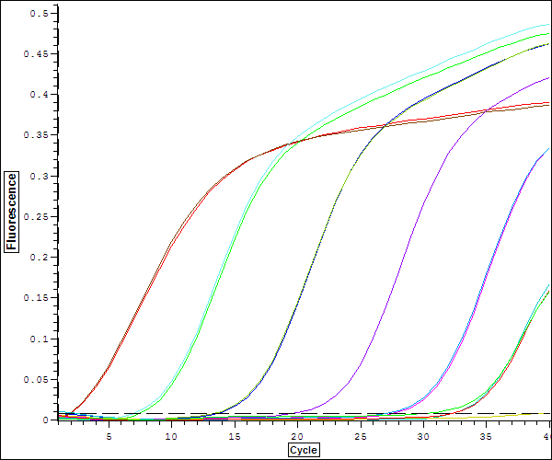
How does Real-Time PCR work?

Slide 24
The advantages of real-time PCR include:
• Ability to monitor the progress of the PCR reaction as it occurs in real time
• Ability to precisely measure the amount of amplicon at each cycle, which allows highly accurate quantification of the amount of starting material in samples
• An increased dynamic range of detection
• Amplification and detection occurs in a single tube, eliminating post-PCR manipulations

Slide 25
How does Real-Time PCR work?
So that’s how traditional PCR is usually presented.
In order to understand real-time PCR, let’s use a “thought experiment”, and save all of the calculations and formulas until later…
Most importantly, we’ll start by imagining the PCR itself, and only then will we draw graphs to illustrate what’s going on.

Slide 26
Imagining Real-Time PCR
To understand real-time PCR, let’s imagine ourselves in a PCR reaction tube at cycle number 25…

Slide 27
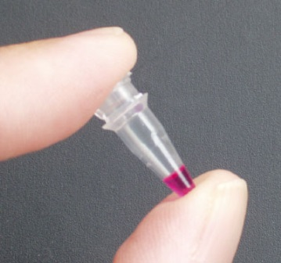
Imagining Real-Time PCR
What’s in our tube, at cycle number 25?
A soup of nucleotides, primers, template, amplicons, enzyme, etc.
~1,000,000 copies of the amplicon right now.

Slide 28
Imagining Real-Time PCR How did we get here?
What was it like last cycle, 24?
Almost exactly the same, except there were only 500,000 copies of the amplicon.
And the cycle before that, 23?
Almost the same, but only 250,000 copies of the amplicon.
And what about cycle 22?
Not a whole lot different. 125,000 copies of the amplicon.

Slide 29
Imagining Real-Time PCR How did we get here?
If we were to graph the amount of DNA in our tube, from the start until right now, at cycle 25, the graph would look like this:

Slide 30
Imagining Real-Time PCR So where are we going?
What’s it going to be like after the next cycle, in cycle 26?
Probably there will be 2,000,000 amplicons.
And cycle 27?
Maybe 4,000,000 amplicons.
And at cycle 200?
In theory, there would be 1,000,000,000,000,000,000,000,000,000,000,000,000,000,000,000,000,000,000,000 amplicons…
?

Slide 31
Imagining Real-Time PCR So where are we going?
If we plot the amount of DNA in our tube going forward from cycle 25, we see that it actually looks like this:
Realistically, at the chain reaction progresses, it gets exponentially harder to find primers, and nucleotides. And the polymerase is wearing out.
So exponential growth does not go on forever!

Slide 32
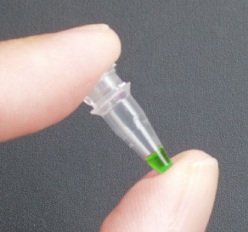
Imagining Real-Time PCR
Measuring Quantities
How can all this be used to measure DNA quantities??
What if YOU started with FOUR times as much DNA template as I did?
I have 1,000,000 copies at cycle 25.
You have 4,000,000 copies!
So… You had 2,000,000 copies at cycle 24.
And… You had 1,000,000 copies at cycle 23.
Notes:
شما تصور کنید میزان DNA من در سیکل 25 تعداد 1000000 کپی است. اگر شما 4000000 کپی داشته باشید سیکل شما چند خواهد بود?

Slide 33
Imagining Real-Time PCR Measuring Quantities
So… if YOU started with FOUR times as much DNA template as I did…
Then you’d reach 1,000,000 copies exactly TWO cycles earlier than I would!

Slide 34
What if YOU started with EIGHT times LESS DNA template than I did?
You’d only have 125,000 copies right now at cycle 25…
…and you’ll have 250,000 at 26, 500,000 at 27, and by cycle 28 you’ll have caught up with 1,000,000 copies!
So… you’d reach 1,000,000 copies exactly THREE cycles later than I would!
Imagining Real-Time PCR Measuring Quantities

Slide 35
The “ct value”
Imagining Real-Time PCR Measuring Quantities
The value that represents the cycle number where the amplification curve crosses an arbitrary threshold.
Ct values are directly related to the starting quantity of DNA, by way of the formula:
Quantity = 2^^{Ct}
Ct Values:
23
25
28
Threshold

Slide 36
PCR
The amount of DNA doubles after each cycle
Assuming 100% efficient PCR reactions
After n cycles there will be 2^{n} times as much DNA
Notes:
First of all we need to think about the nature of the PCR reaction in order to understand real time quantitation. The amount of DNA theoretically doubles with every cycle of PCR and this is what this shows, after each cycle the amount of DNA is twice what it was before.
After one cycle of PCR, the amount of DNA is twice what it was before, so after two cycles one has 2x2 times as much, after 3 cycles - 2x2x2 times as much or 2³ times as much, after 4 cycles 2x2x2x2 times as much or 2⁴ times as much. Thus after n cycles there will be 2^{n} times as much DNA.

Slide 38
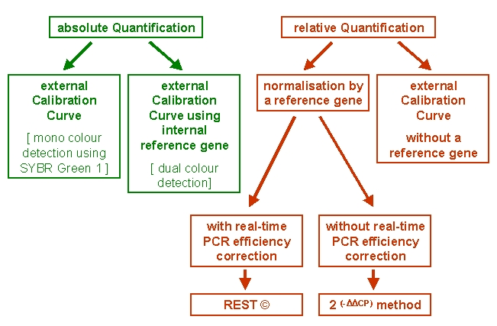

Slide 39
Two strategies can be performed in real-time RT-PCR:
The levels of expressed genes may be measured by absolute or relative quantitative real-time RT-PCR.
Absolute quantification relates the PCR signal to input copy number using a calibration curve
Relative quantification measures the relative change in mRNA expression levels.

Slide 40
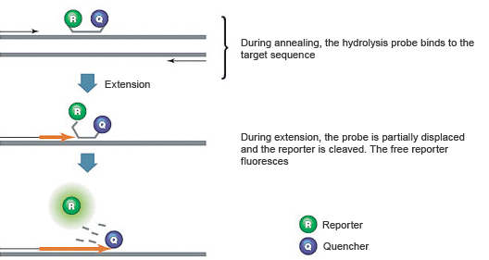
TaqMan® probes = Double-Dye probes
TaqMan® probes, also called Double-Dye Oligonucleotides, Double-Dye Probes, or Dual Labelled probes, are the most widely used type of probes.
Consisted of a single-stranded probe sequence that was complementary to one of the strands of the amplicon.
A fluorophore is attached to the 5’ end of the probe and a quencher to the 3’ end.

Slide 41
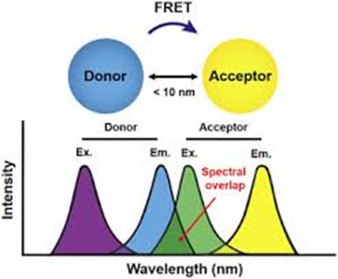
The fluorophore is excited by the machine and passes its energy, via FRET (Fluorescence Resonance Energy Transfer) to the quencher.
FRET is a through-space mechanism in which energy from the reporter dye is transferred to the quencher without absorption or emission of light.

Slide 42
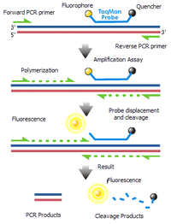

Slide 43
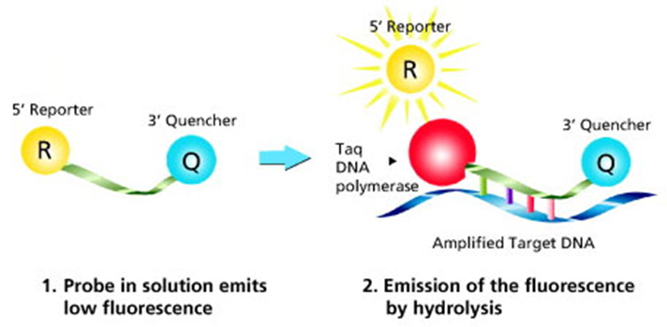
FAM as the fluorophore (reporter)
TAMRA as the quencher
In a well designed probe FAM does not fluoresce as it passes its energy onto TAMRA.
The probe binds to the amplicon during each annealing step of the PCR.
When the Taq polymerase extends from the primer which is bound to the amplicon, it displaces the 5’ end of the probe, which is then degraded by the 5’-3’ exonuclease activity of the Taq polymerase.
Cleavage continues until the remaining probe melts off the amplicon

Slide 44
Reporter in qPCR

Slide 46
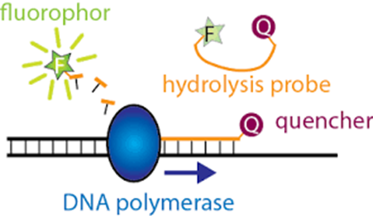
This process releases the fluorophore and quencher into solution, spatially separating them (compared to when they were held together by the probe).
This leads to an irreversible increase in fluorescence from the FAM and a decrease in the TAMRA

Slide 47
Double-Dye probes advantages
• Widely used, several modifications possible
• Specific system
• Multiplex capabilities
Double-Dye probes disadvantages
• More expensive than SYBR® Green I, but the lowest cost specific system available

Slide 49
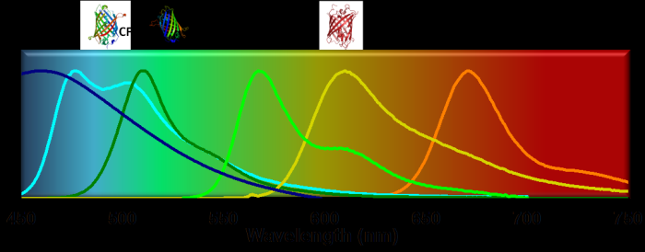

Slide 50
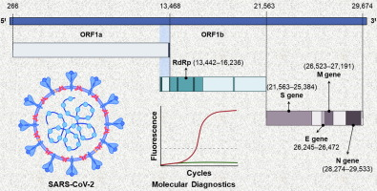
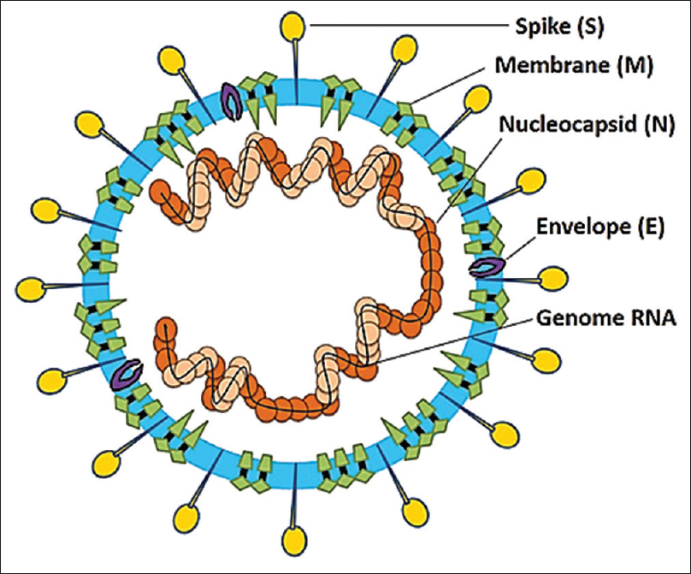
Real Time PCR in covid 19
Absoulote quantification
Probe ( FAM, HEX, ROX,CY5)
ORF1b, N, RdRp, E, ORF1a

Slide 51
Reporter in qPCR

Slide 52
Reporter in qPCR

Slide 54
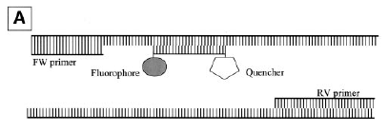
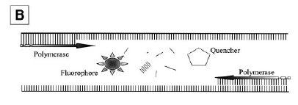
TaqMan probes
Sequence-specific
Doesn´t need much optimization
More expensive

Slide 55
SYBRgreen
dsDNA intercalating dye
Unspecific (optimization)
cheap
How do We Measure DNA in a PCR Reaction?
3’
5’
5’
3’
5’
3’
5’
3’
Extension
3’
ID
ID
Taq
5’
5’
5’
ID
ID
ID
5’
Taq
3’
Apply Excitation
Wavelength
λ
λ
λ
Taq
3’
ID
ID
ID
5’
5’
Taq
ID
ID
5’
3’
λ
λ

Slide 56
Melting curve
Once the amplification reaction is completed and the fluorescence signals are recorded, the template is melted for the determination of the non-specific bindings.
The template is melted using heating, the dye dissociates and the fluorescence signals are reduced.
The decreased transition of a wide range fluorescence is reported for the specific product while different heat transition recorded for different short non-specific bands.
“Larger sequences takes more time and higher temperature for melting while non-specific bands melt at a lower temperature and has different melting temperature curves.”

Slide 57
Melting temperature of a dsDNA target depends on:
GC content
length
sequence

Slide 58
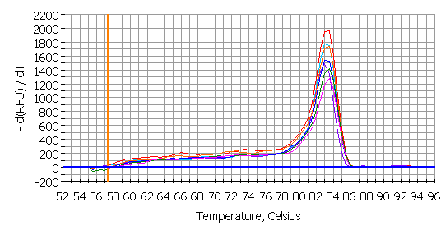
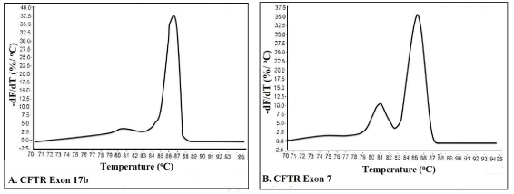
Melting curve – Test the presence of unspecific amplification, contamination, primer dimers,..

Slide 59
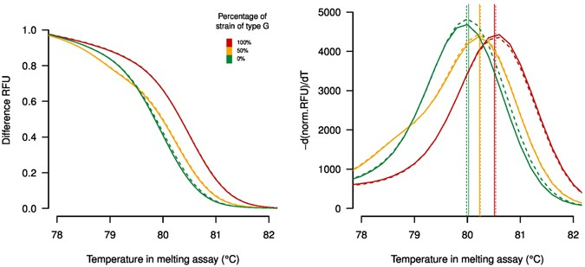
High Resolution Melting dyes (HRM dyes)
High Resolution Melt curve analysis is a newly emerging technology, which characterizes nucleic acid samples based on their dissociation behaviour.

Slide 60
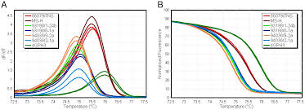
HRM uses the fundamental property of the separation of the two strands of DNA with heat (melting), and the monitoring of this melting with a fluorescent dye.

Slide 61
Due to the high sensitivity of HRM dyes, even a single base change will induce differences in the melting curve, and consequently in fluorescence
Main applications of HRM include:
gene scanning (search for the presence of unknown variations in PCR amplicons),
SNP genotyping,
DNA methylation analysis, DNA mapping,
DNA fingerprinting.

Slide 62
High Resolution Melt (HRM) analysis
A powerful technique in molecular biology for the detection:
mutations, polymorphisms and epigenetic differences in double-stranded DNA samples.

Slide 63
It has advantages over other genotyping technologies, namely:
It is cost-effective vs. other genotyping technologies such as sequencing and TaqMan SNP typing.
This makes it ideal for large scale genotyping projects.
It is fast and powerful thus able to accurately genotype many samples rapidly.
It is simple.
With a good quality HRM assay, powerful genotyping can be performed by non-geneticists in any laboratory with access to an HRM capable real-time PCR machine.

Slide 64
This emerging method is less expensive and as precise than probe-based methods.
Roche LightCycler®480, the Corbett Life Science Rotor-Gene™ 6000, and the ABI Prism® 7500.
The main HRM dyes available are EvaGreen, LCGreen®, SYTO® 9 and BEBO.

Slide 65
Efficiency OF Real Time PCR

Slide 66
PCR
The amount of DNA doubles after each cycle
Assuming 100% efficient PCR reactions
After n cycles there will be 2^{n} times as much DNA
Notes:
First of all we need to think about the nature of the PCR reaction in order to understand real time quantitation. The amount of DNA theoretically doubles with every cycle of PCR and this is what this shows, after each cycle the amount of DNA is twice what it was before.
After one cycle of PCR, the amount of DNA is twice what it was before, so after two cycles one has 2x2 times as much, after 3 cycles - 2x2x2 times as much or 2³ times as much, after 4 cycles 2x2x2x2 times as much or 2⁴ times as much. Thus after n cycles there will be 2^{n} times as much DNA.

Slide 67
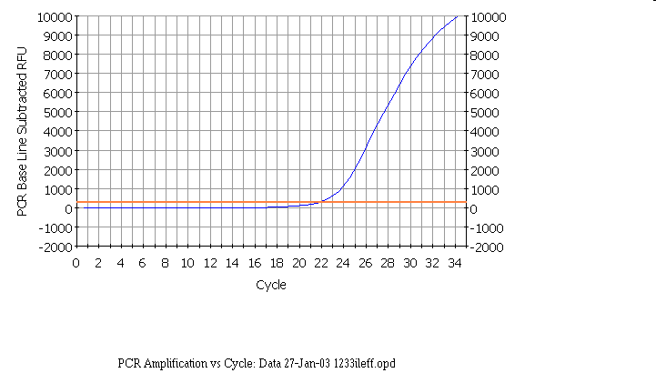
Notes:
In the following discussion the results shown will be those obtained in our laboratory using a BioRad Icycler Real-time PCR instrument. However, analysis with other instruments is similar.
Here is a real-time PCR trace for a single well on a 96-well plate, cycles are shown along the X-axis, and arbitrary fluorescence units (actually these are fold increase over background fluorescence) are shown on the Y-axis - the results are similar to our theoretical graph (see insert) - except that the transition to the plateau phase is more gradual. This expt - and everything we are going to discuss - was done with SYBR green, which has very low fluorescence in the absence of double stranded DNA and very high fluorescence in the presence of double stranded DNA.

Slide 68
Plot of real time pcr

Slide 70
Rn: Normalized reporter is the ratio of the fluorescence emission intensity of the reporter dye to the fluorescence emission intensity of the passive reference dye
ΔRn is the normalization of Rn obtained by subtracting the baseline: (ΔRn = Rn –baseline).

Slide 71
The Rn value, or normalized reporter value, is the fluorescent signal from SYBR Green normalized to (divided by) the signal of the passive reference dye for a given reaction.
The delta Rn value is the Rn value of an experimental reaction minus the Rn value of the baseline signal generated by the instrument.
This parameter reliably calculates the magnitude of the specific signal generated from a given set of PCR conditions.

Slide 72
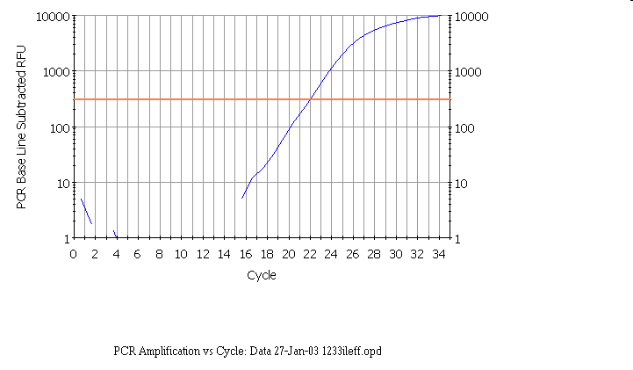
Notes:
Here is the same real time PCR trace shown on a logarithmic scale - again it is similar to our theoretical curve (inset).

Slide 73
Linear ~20 to ~1500
Notes:
As we saw with the theoretical curves, you should get a straight line relationship in the linear part of the PCR reaction. In this case the reaction is linear from ~20 to ~1500 arbitrary fluorescence units.

Slide 74
Linear ~20 to ~1500 Fluorescent Units
Arithmetic scale
PCR baseline subtracted RFU
Same region as log scale
Cycle number
Notes:
If we look at the same region on a regular scale, we see the linear part is the very early part of the curve and note that it is NOT the region which looks linear in this graphical view. This is a very important point in real-time PCR because we wish to examine the reaction while it is still in the linear log phase.

Slide 75
threshold = 300
Notes:
It is important that the threshold should be in the linear part of the reaction - this is easier to see in the logarithmic view, where it should be no more than half way up the linear part, in the regular view, the threshold will be close to the bottom of the curve. However, the threshold should be high enough that you are sure that reactions cross the line due to amplification rather than noise. We find that if the plateau values are 4000 to to 15000, a threshold of 300 usually works well.
We use the same threshold for all the samples in the same experiment on the same plate.

Slide 76
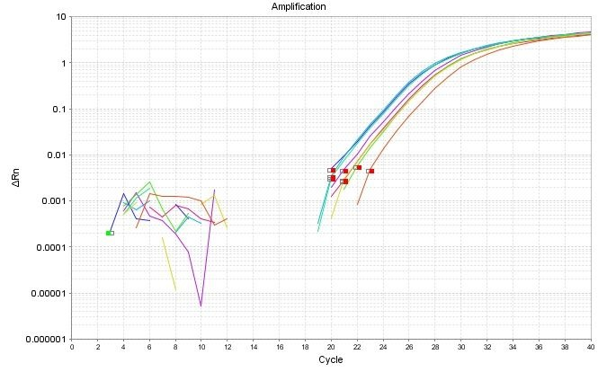
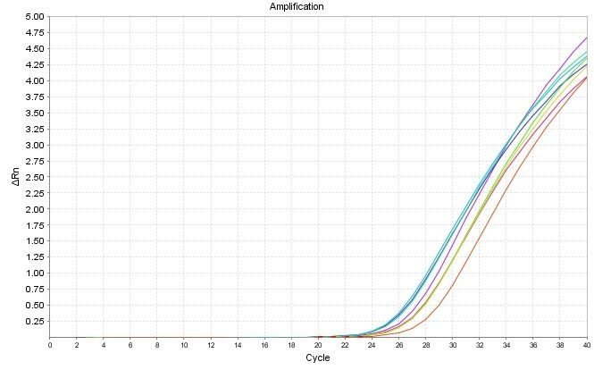
Amplification curve:
log view
Always use during analysis
Plateau
Exponential
Linear
Amplification curve:
linear view

Slide 77
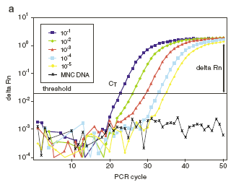
Endpoint analysis
Different concentrations give similar endpoint results!

Slide 78
…So that’s how PCR is usually presented.
To understand real-time PCR, let’s imagine ourselves in a PCR reaction tube at cycle number 25…
Imagining Real-Time PCR

Slide 79
Imagining Real-Time PCR
What’s in our tube, at cycle number 25?
A soup of nucleotides, primers, template, amplicons, enzyme, etc.
~1,000,000 copies of the amplicon right now.

Slide 80
Imagining Real-Time PCR How did we get here?
What was it like last cycle, 24?
Almost exactly the same, except there were only 500,000 copies of the amplicon.
And the cycle before that, 23?
Almost the same, but only 250,000 copies of the amplicon.
And what about cycle 22?
Not a whole lot different. 125,000 copies of the amplicon.

Slide 81
Imagining Real-Time PCR How did we get here?
If we were to graph the amount of DNA in our tube, from the start until right now, at cycle 25, the graph would look like this:

Slide 82
Imagining Real-Time PCR So where are we going?
What’s it going to be like after the next cycle, in cycle 26?
Probably there will be 2,000,000 amplicons.
And cycle 27?
Maybe 4,000,000 amplicons.
And at cycle 200?
In theory, there would be 1,000,000,000,000,000,000,000,000,000,000,000,000,000,000,000,000,000,000,000 amplicons…
?

Slide 83
Imagining Real-Time PCR So where are we going?
If we plot the amount of DNA in our tube going forward from cycle 25, we see that it actually looks like this:
Realistically, at the chain reaction progresses, it gets exponentially harder to find primers, and nucleotides. And the polymerase is wearing out.
So exponential growth does not go on forever!

Slide 84
Imagining Real-Time PCR
Measuring Quantities
How can all this be used to measure DNA quantities??
What if YOU started with FOUR times as much DNA template as I did?
I have 1,000,000 copies at cycle 25.
You have 4,000,000 copies!
So… You had 2,000,000 copies at cycle 24.
And… You had 1,000,000 copies at cycle 23.
Notes:
شما تصور کنید میزان DNA من در سیکل 25 تعداد 1000000 کپی است. اگر شما 4000000 کپی داشته باشید سیکل شما چند خواهد بود?

Slide 85
Imagining Real-Time PCR Measuring Quantities
So… if YOU started with FOUR times as much DNA template as I did…
Then you’d reach 1,000,000 copies exactly TWO cycles earlier than I would!

Slide 86
What if YOU started with EIGHT times LESS DNA template than I did?
You’d only have 125,000 copies right now at cycle 25…
…and you’ll have 250,000 at 26, 500,000 at 27, and by cycle 28 you’ll have caught up with 1,000,000 copies!
So… you’d reach 1,000,000 copies exactly THREE cycles later than I would!
Imagining Real-Time PCR Measuring Quantities

Slide 87
The “ct value”
Imagining Real-Time PCR Measuring Quantities
The value that represents the cycle number where the amplification curve crosses an arbitrary threshold.
Ct values are directly related to the starting quantity of DNA, by way of the formula:
Quantity = 2^^{Ct}
Ct Values:
23
25
28
Threshold

Slide 89
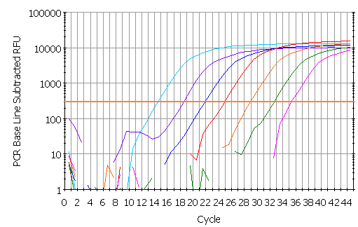
threshold
Ct

Slide 90
There’s a DIRECT relationship between the starting amount of DNA, and the cycle number that you’ll reach an arbitrary number of DNA copies (Ct value).
DNA amount = 2 ^ Cycle Number
Imagining Real-Time PCR Measuring Quantities

Slide 91
How do We Measure DNA in a PCR Reaction?
We use reagents that fluoresce in the presence of amplified DNA!
Ex. SYBR Green dye
They bind to double-stranded DNA and emit light when illuminated with a specific wavelength.

Slide 92
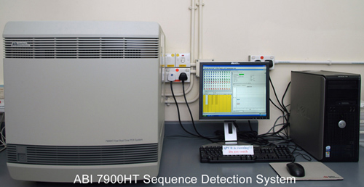
Real-time PCR instruments consist of TWO main components:
Thermal Cycler (PCR machine)
Optical Module (to detect fluorescence in the tubes during the run)
What Type of Instruments are used with Real-Time PCR?

Slide 93
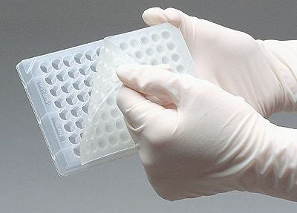
What Type of Instruments are used with Real-Time PCR?
Adequate, optical plates
96/384 wells
Standard/fast
Optical sealing adhesive

Slide 95
Absolute quantification using the standard curve method
Important guidelines
The following guidelines are critical to correctly using the standard curve method for absolute quantitation:
It is important that it is a single, pure species of DNA or RNA. For example, plasmid DNA from E. coli is often contaminated with RNA, as a result of which the A260 value increases and the number of copies determined for the plasmid is increased.
Since the standards have to be diluted over several orders of magnitude, precise pipetting is required. Plasmid DNA or in vitro transcribed RNA must be available in concentrated form in order to be able to measure an exact A260 value. This concentrated DNA or RNA must then be diluted 106-1012 fold to make its concentration equal to that of the target in biological samples.
The stability of the diluted standards must be taken into account, especially for RNA. Divide the diluted standards into small aliquots, store them at -80 ° C and thaw them only once before use.
In principle, DNA cannot be used as a standard for the absolute quantification of RNA, since there is no control with regard to the efficiency of the reverse transcription step.

Slide 96
Standards
The absolute amounts of the standards must first be determined using independent methods.
Mostly plasmid DNA and in vitro transcribed RNA are used to produce absolute standards.
The concentration is measured at A260 and converted into the number of copies based on the molecular weight of the DNA or RNA.

Slide 98
First basic underlying principle: every cycle there is a doubling of product.
Second basic principle: we do not need to know exact quantities of DNA, instead we will only deal with relative quantities.
Third basic principle: we have to have not only a “target” gene but also a “normalizer” gene.
Key formula:
Quantity = 2 ^ ^{(Ct}_{a} ^{– Ct}_{b}⁾
Quantification and Normalization

Slide 99
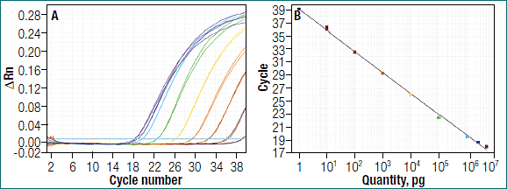
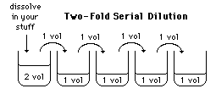
Standard Curve
Quantification and Normalization
Prepare a 2-fold serial dilution of a DNA sample:
Recomendation: add always a standard curve in every run

Slide 100
E = 10 [–1/slope]

Slide 101
E = 10^(-1/slope)
E = (10^(-1/slope)-1)*100
Ex. slope = -3,81
efficency= (10^(-1/-3.81)-1)*100 = 83%
Ideal: efficency >95%

Slide 102
Correlation coefficient (R2)
The correlation coefficient is a measure of how well the data fit the standard curve.
The R2 value reflects the linearity of the standard curve.
Ideally, R2 = 1, although 0.999 is generally the maximum value.

Slide 104
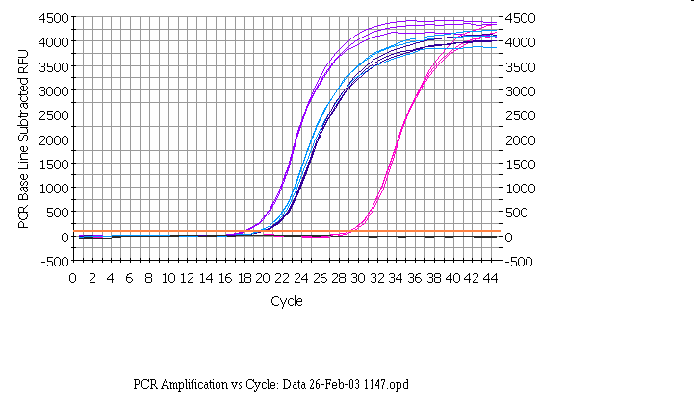
IL1-b vit
RPLP0 con
RPLP0 vit
IL1-b con
Notes:
Here are the results from an experiment in which the target gene was IL1-beta and the reference gene was RPLPO. RNA was extracted from control (con) or vitreous-treated (vit) cells, and copied into cDNA. IL1-b and RPLP0 assays were done in triplicate on both con and vit cDNAs.
We will start by looking at the top part of the “Northern equation” - that is determining the fold change in IL1-b in vitreous compared to control.

Slide 105
ΔΔCt
EFFICIENCY
METHOD
APPROXIMATION METHOD
Notes:
This method was one of the first methods to be used to calculate these type of results. However, as we shall see, it is an approximation method. It makes various assumptions, and to prove that they are valid is, in our opinion, more time consuming that doing a few extra efficiency runs for the Pfaffl method.

Slide 106
IL1-b vit
RPLP0 con
RPLP0 vit
IL1-b con
Notes:
If one looks at the same data that we discussed before. But for the time being ignore the data from the standard ‘loading control’ gene. The difference between the control and treated samples for il1-beta is shown by the red line. If we know the efficiency for il1-beta and the cycle number, we could calculate the fold change in il-1 beta- but there would be no loading control.

Slide 107
Notes:
An approximate correction can be made for the loading control by calculating the difference between the IL1-beta Ct values and the RPLP0 values for the control samples, and then for the vitreous treated samples (represented by the two green lines in the slide). This makes an allowance for the fact that in the above case, there is slightly more mRNA in the vitreous treated samples (since the RPLP0 comes up slightly earlier). This difference (or delta Ct value) is shown by the two green lines above. The difference between the two delta values represents the shift as will be seen in the next slide.

Slide 108
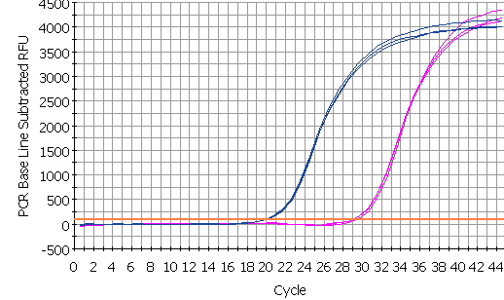
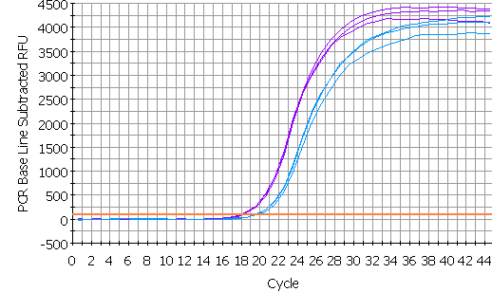
control
Δ Ct = target - ref
RPLP0 con
Δ Ct = 9.70
IL1-b con
av =19.93
av =29.63
experiment
Δ Ct = target - ref
IL1-b vit
Δ Ct = -1.7
RPLP0 vit
Difference = ΔCt-ΔCt
= ΔΔCt
= 9.70-(-1.7)
= 11.40
av =18.03
av =19.80
Notes:
The difference between the two delta Ct values (delta delta Ct, represents the corrected shift of the IL1-b. Since in this example in the vitreous treated sample the IL1-b has moved to the left of the standard, it has a negative value, but in maths subtraction of a negative value is equivalent to adding that value - which makes obvious sense (I hope) if you look at the diagram - the total shift is = the two green arrows added together. If the vit il1-b had shifted but remained to the right of the reference curve, the value would then be subtracted from the large green arrow to determine the shift.

Slide 109
ΔΔCt = 11.40 for IL1-beta
2 ^{ΔΔCt} variant: assumes efficiency is 100% Fold change = 2^{11.40} = 2702
But our efficiency for IL1-beta is 93%
Fold change = 1.93^{11.40} = 1800
Pfaffl equation corrected for RPLP0 efficiency
Fold change = 1901
Notes:
Note how different the results are when the correct efficiency is used rather than assuming 100%. The results are much closer to the ones calculated with the accurate method. However, note that the efficency of the RPLP0 was never taken into account with this approximation method. This method assumes that the efficiency of RPLP0 is so close to that of IL1-beta that it does not make much difference - or that the reference gene values are so similar for different RNA samples that the correction is so small that it would not be significant (it was only 1.08 fold when we calculated the change in RPLP0 cDNA for these same samples when discussing the Pfaffl method).

Slide 110
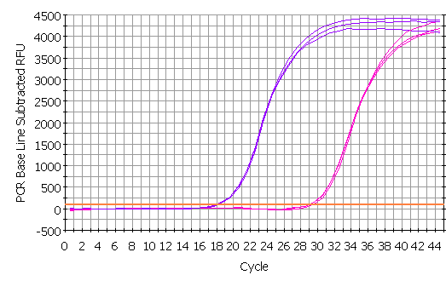
IL1-beta
IL1-b vit
IL1-b con
av =18.03
av =29.63
AFTER N CYCLES: change = (efficiency)^{n}
AFTER N CYCLES: ratio vit/con = (1.93)^{29.63-18.03} =1.93^{11.60} = 2053
Notes:
So here we are just looking at the results from the wells containing the IL1-b primers. If we look at the difference in Ct values between the control and vitreous samples we see there is an 11.60 cycle difference. Earlier on we derived the equation that the change in amount of DNA after n cycles is equal to the efficiency to the power of n. We independently do multiple serial dilution curves on multiple days to determine an average efficiency and we can then plug that value into the formula. Note that when determining the difference in the Ct values (sometimes known as the ‘delta Ct’), we subtract the vitreous from the control value - this is so that increases will have a positive result and decreases a negative result for the delta Ct value.
If the amount of RNA is less in the vitreous sample the delta Ct would have a negative value and the change would have a value of less than 1.00. So, if there was half as much target mRNA the value for the change would be 0.5.
These calculations are easily done if you have an excel spreadsheet set up (see later slide).

Slide 111
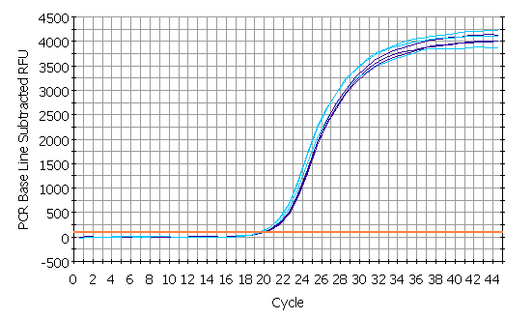
RPLP0
RPLP0 con
RPLP0 vit
av =19.80
av =19.93
AFTER N CYCLES: change = (efficiency)^{n}
AFTER N CYCLES: ratio vit/con = (1.87)^{19.93-19.80} =1.87^{0.13} = 1.08
Notes:
Here we are just looking at the RPLP0 data - note, that, as expected for a good reference gene, there is not much difference between the two RNAs with regard to their levels of RPLP0 mRNA. The same amount of total RNA was used for reverse transcription of both RNAs, and the same amount of each reverse transcription reaction was used for real-time PCR. Since the Ct values are so close and the ratio of the reference gene in the two samples is close to one, this suggests that this is a good reference gene for these experiments.
Of course this method requires that you have determined the efficiency for your primers. We do this on multiple occasions, using the criteria for a good curve discussed above. We find that the values tend to be very reproducible if we use stabilized sybr green mixes. If we change manufacturer or if the formulation is changed, the efficiency will need to be determined again.

Slide 112
“normalizer” gene
Quantification and Normalization
Knowing the amount of mRNA in one sample from one specific gene does not tell us much..
You need to know the total amount of mRNA in your sample
You also dont know how much the mRNA level has changed compared to other mRNA levels
Example:
mRNA levels of a gene increase 2x after induction
It is possable that all (1) genexpression in the cell has increased (2) the induced samples contained more total mRNA
→We have to compare the expression of our gene to another gene which expression is normally constant, a housekeeping gene (ex. TBP, 18S)

Slide 113
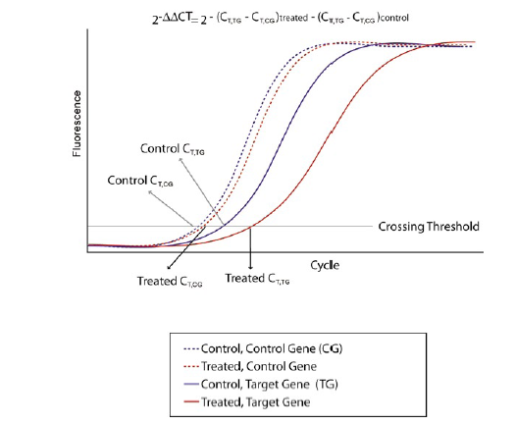
ΔΔCt method
experiment
control
-[(Ct_{tg}-Ct_{cg})-(Ct_{tg}-Ct_{cg})]
2
Ex!
Ct = target gene– ref gene
Δ Ct = 9.70
Ct = target gene– ref gene
Δ Ct = -1.70
Difference = ΔCt-ΔCt
= ΔΔCt
= 9.70-(-1.7)
= 11.40
Fold change = 2^{11.40} = 2702
Always in duplicate or triplicate!

Slide 114
Calculando a eficiência dos primers em qPCR
Ideal: N = N₀.2^{n}
N = número de moléculas amplificadas
N₀ = número de moléculas inicial
n = Número de ciclos
threshold
Ct
Curva padrão

Slide 115
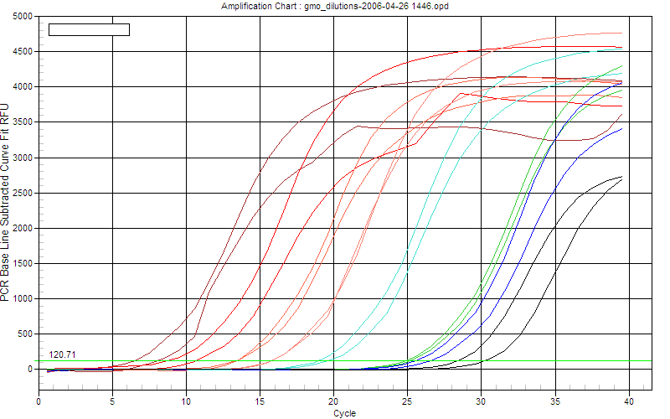
Quantification
and
Normalization

Slide 117
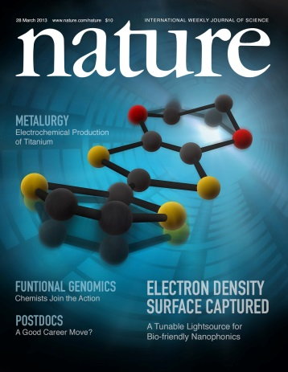
Results?
Good experimental design
Optimal primers
Good RNA
Good cDNA
Adequate nr of samples
Adequate nr of replicates
Good STATISTICS
Gene | Value | Call
A | 1.828745739 | up regulated
B | 2.04179718 | up regulated
C | 0.666738198 | unaffected
D | 1.999855536 | up regulated
E | - 0.450673805 | unaffected
F | 0.509327854 | unaffected
G | - 1.195371388 | down regulated
UCE | 0 | control gene

Slide 118
سپاس از توجه شما

Slide 123
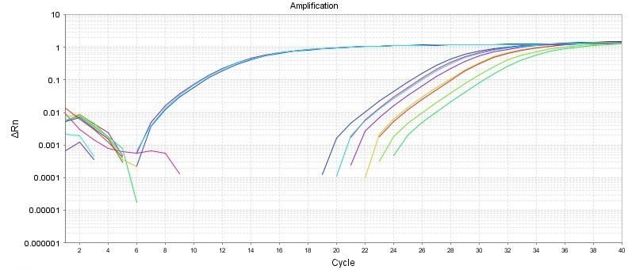
Good Comparative Ct example
(for gene expression)
Endogenous control
Gene of interest
Small variation in endogenous control Ct values
Shape of curve, including linear phase (log view)

Slide 124
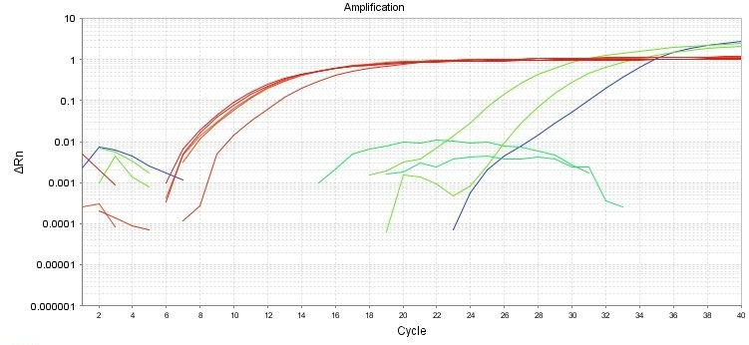
1
Bad Comparative Ct example
1
2
2
3
Too much variation in endogenous control Ct values
Sigmoidal curves. Check baseline levels
No amplification

Slide 125
Endogenous control gene:
Present in all experimental samples
Expression does not vary between treatments, tissues, age, etc. i.e. constant expression levels
By using an endogenous control as an active reference you can normalize quantification of mRNA target for differences in the amount of total RNA added to each sample. i.e. loading control
Commonly used: 18S or 25S rRNA, actin, GAPDH, ubiquitin, etc

Slide 126
Reference sample
Used in Comparative C_{T} and relative standard curve experiments
Sample used as the basis for relative quantitation results. i.e. Everything gets expressed and compared relative to this sample.
Also called calibrator
It doesn’t matter which sample is used, however normally the negative control is used.

Slide 127
Amplification curve:
log view
Always use during analysis
Plateau
Exponential
Linear
Amplification curve:
linear view

Slide 128
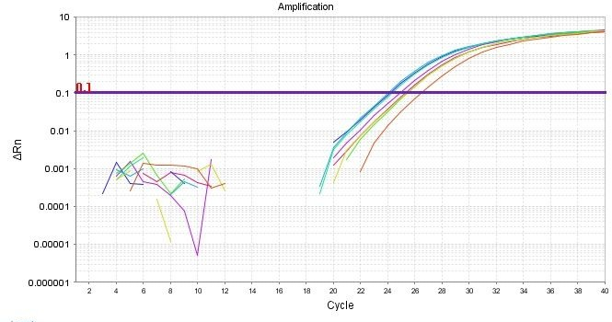
It's all about Ct
Threshold
Ct

Slide 129
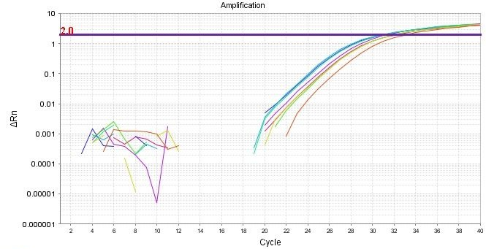
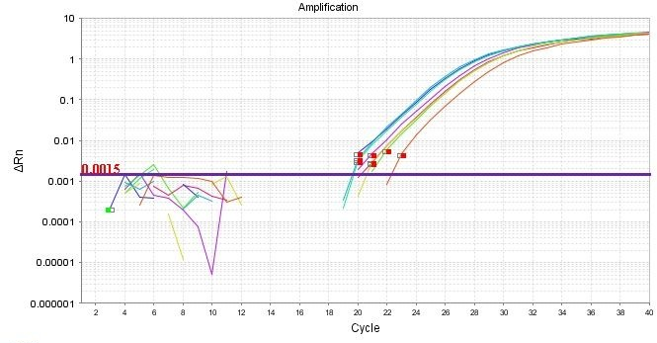
Threshold set too high
Threshold set too low

Slide 130
Threshold is important
Threshold determines Ct values
Ct values are used to calculate relative expression, presence/absence, etc. It's all about Ct values
Threshold should be set in the linear portion (parallel lines) in log view. Always check!
Do not use Ct values of 35 or higher. Repeat using more cDNA/DNA

Slide 131
Good Comparative Ct example
(for gene expression)
Endogenous control
Gene of interest
Small variation in endogenous control Ct values
Shape of curve, including linear phase (log view)

Slide 132
1
Bad Comparative Ct example
1
2
2
3
Too much variation in endogenous control Ct values
Sigmoidal curves. Check baseline levels
No amplification

